Slide 1
C++ Programming Language

Slide 2
Difference between C and C++
POINT | C | C++
Developed by | C was developed by Dennis Ritchie between the year 1969 and 1973 at AT&T Bell Labs. | C++ was developed by Bjarne Stroustrup in 1979.
Concepts Supported | C does no support polymorphism, encapsulation, and inheritance which means that C does not support object oriented programming. | C++ supports polymorphism, encapsulation, and inheritance because it is an object oriented programming language.
Procedural and Object oriented Programming | For the development of code, C supports procedural programming. | C++ is known as hybrid language because C++ supports both procedural and object oriented programming paradigms.
Data and Functions | Data and functions are separated in C because it is a procedural programming language. | Data and functions are encapsulated together in form of an object in C++.
Information Hiding | C does not support information hiding. | Data is hidden by the Encapsulation to ensure that data structures and operators are used as intended.
Built in Types | Built-in data types is supported in C. | Built-in & user-defined data types is supported in C++.

Slide 3
POINT | C | C++
Namespaces | Namespace features are not present inside the C. | Namespace is used by C++, which avoid name collisions.
Standard Header File | Standard IO header is stdio.h. | Standard IO header is iostream.h.
Reference Variable | Reference variables are not supported by C. | Reference variables are supported by C++.
Dynamic Memory Allocation | C provides malloc() and calloc() functions for dynamic memory allocation, and free() for memory de-allocation. | C++ provides new operator for memory allocation and delete operator for memory de-allocation.
Exception Handling | Direct support for exception handling is not supported by C. | Exception handling is supported by C++.
Input and Output Functions | scanf() and printf() functions are used for input/output in C. | cin and cout are used for input/output in C++.
Access Modifiers | C structures don’t have access modifiers. | C ++ structures have access modifiers.
Overloading | C does not support overloading | C++ does support overloading
File Extension | File extension is “.c” | File extension is “.cpp” or “.c++” or “.cc” or “.cxx”
Keywords | There are 32 keywords in the C | There are 97 keywords in the C++

Slide 4
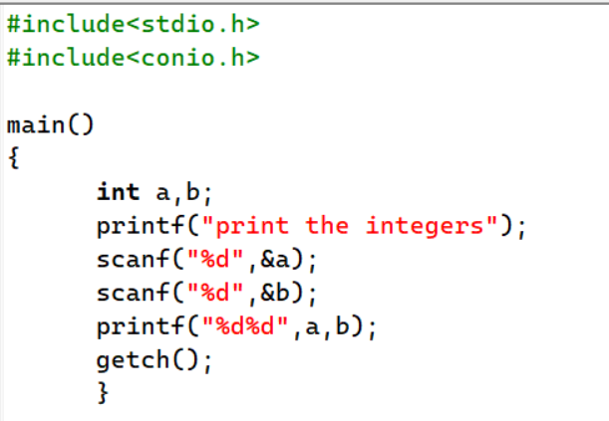
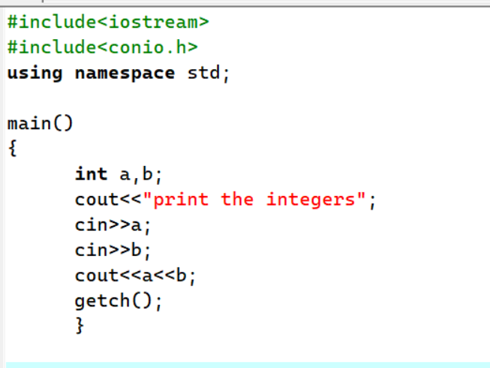
SIMPLE CODE DIFFERENCE OF C & C++
Printing in C Language
PRINTING THE SAME CODE IN C++

Slide 5
Why Program?
Computer – programmable machine designed to follow instructions
Program – instructions in computer memory to make it do something
Programmer – person who writes instructions (programs) to make computer perform a task
SO, without programmers, no programs; without programs, a computer cannot do anything

Slide 6
Main Hardware Component Categories:
Central Processing Unit (CPU)
Main Memory
Secondary Memory / Storage
Input Devices
Output Devices

Slide 7
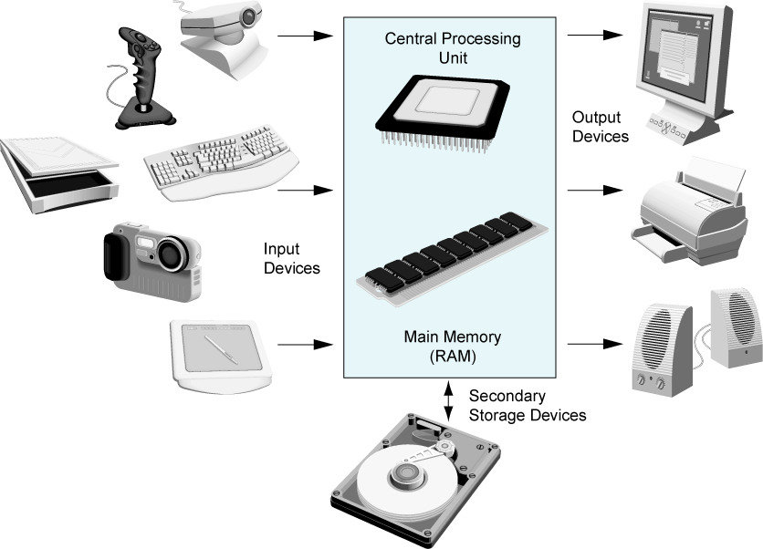
Main Hardware Component Categories
Figure 1-1

Slide 8
Secondary Storage
Non-volatile: data retained when program is not running or computer is turned off
Comes in a variety of media:
magnetic: floppy disk, hard drive
optical: CD-ROM, DVD
Flash drives, connected to the USB port

Slide 9
Input Devices
Devices that send information to the computer from outside
Many devices can provide input:
Keyboard, mouse, scanner, digital camera, microphone
Disk drives, CD drives, and DVD drives

Slide 10
Output Devices
Output is information sent from a computer program to the outside world.
The output is sent to an output device
Many devices can be used for output:
Computer monitor and printer
Disk drives
Writable CD and DVD drives

Slide 11
Software – Programs That Run on a Computer
Categories of software:
Operating system: programs that manage the computer hardware and the programs that run on them. Examples: Windows, UNIX, Linux
Application software: programs that provide services to the user. Examples : word processing, games, programs to solve specific problems

Slide 12
Programs and Programming Languages
A program is a set of instructions that the computer follows to perform a task
We start with an algorithm, which is a set of well-defined steps.

Slide 13
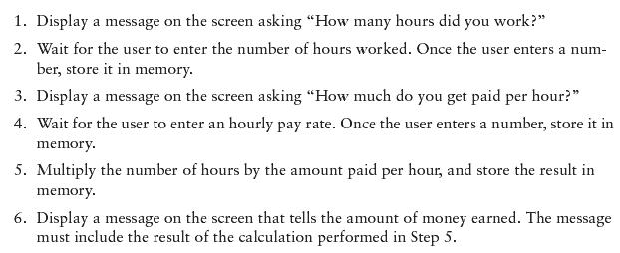
Example Algorithm for Calculating Gross Pay

Slide 14
Machine Language
Although the previous algorithm defines the steps for calculating the gross pay, it is not ready to be executed on the computer.
The computer only executes machine language instructions.

Slide 15
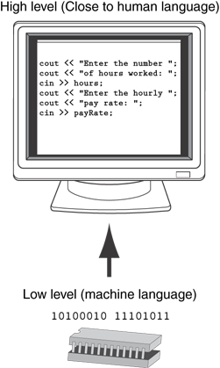
Programs and Programming Languages
Types of languages:
Low-level: used for communication with computer hardware directly. Often written in binary machine code (0’s/1’s) directly.
High-level: closer to human language

Slide 16
From a High-level Program to an Executable File
Create file containing the program with a text editor.
Run preprocessor to convert source file directives to source code program statements.
Run compiler to convert source program into machine instructions.
Run linker to connect hardware-specific code to machine instructions, producing an executable file.
Steps b–d are often performed by a single command or button click.
Errors detected at any step will prevent execution of following steps.

Slide 17
From a High-level Program to an Executable File
Source Code
Object Code
Preprocessor
Linker
Modified
Source Code
Executable Code
Compiler

Slide 18
Integrated Development Environments (IDEs)
An integrated development environment, or IDE, combine all the tools needed to write, compile, and debug a program into a single software application.
Examples are Microsoft Visual C++, Turbo C++ Explorer, CodeWarrior, etc.

Slide 19
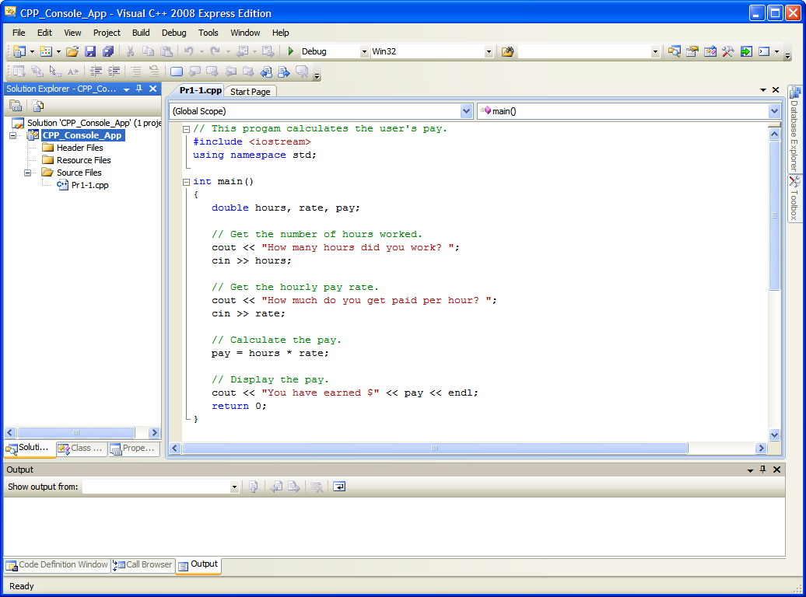

Integrated Development Environments (IDEs)

Slide 20
What Is a Program Made Of?
Common elements in programming languages:
Key Words
Programmer-Defined Identifiers
Operators
Punctuation
Syntax

Slide 21
Program 1-1
1 // This program calculates the user's pay. 2 #include <iostream> 3 using namespace std; 4 5 int main() 6 { 7 double hours, rate, pay; 8 9 // Get the number of hours worked. 10 cout << "How many hours did you work? "; 11 cin >> hours; 12 13 // Get the hourly pay rate. 14 cout << "How much do you get paid per hour? "; 15 cin >> rate; 16 17 // Calculate the pay. 18 pay = hours * rate; 19 20 // Display the pay. 21 cout << "You have earned $" << pay << endl; 22 return 0; 23 }

Slide 22
Key Words
Also known as reserved words
Have a special meaning in C++
Can not be used for any other purpose
Key words in the Program 1-1: using, namespace, int, double, and return.

Slide 23
Key Words
1 // This program calculates the user's pay. 2 #include <iostream> 3 using namespace std; 4 5 int main() 6 { 7 double hours, rate, pay; 8 9 // Get the number of hours worked. 10 cout << "How many hours did you work? "; 11 cin >> hours; 12 13 // Get the hourly pay rate. 14 cout << "How much do you get paid per hour? "; 15 cin >> rate; 16 17 // Calculate the pay. 18 pay = hours * rate; 19 20 // Display the pay. 21 cout << "You have earned $" << pay << endl; 22 return 0; 23 }

Slide 24
Programmer-Defined Identifiers
Names made up by the programmer
Not part of the C++ language
Used to represent various things: variables (memory locations), functions, etc.
In Program 1-1: hours, rate, and pay.

Slide 25
Programmer-Defined Identifiers
1 // This program calculates the user's pay. 2 #include <iostream> 3 using namespace std; 4 5 int main() 6 { 7 double hours, rate, pay; 8 9 // Get the number of hours worked. 10 cout << "How many hours did you work? "; 11 cin >> hours; 12 13 // Get the hourly pay rate. 14 cout << "How much do you get paid per hour? "; 15 cin >> rate; 16 17 // Calculate the pay. 18 pay = hours * rate; 19 20 // Display the pay. 21 cout << "You have earned $" << pay << endl; 22 return 0; 23 }

Slide 26
Operators
Used to perform operations on data
Many types of operators:
Arithmetic - ex: +,-,*,/
Assignment – ex: =
Some operators in Program1-1: << >> = *

Slide 27
Operators
1 // This program calculates the user's pay. 2 #include <iostream> 3 using namespace std; 4 5 int main() 6 { 7 double hours, rate, pay; 8 9 // Get the number of hours worked. 10 cout << "How many hours did you work? "; 11 cin >> hours; 12 13 // Get the hourly pay rate. 14 cout << "How much do you get paid per hour? "; 15 cin >> rate; 16 17 // Calculate the pay. 18 pay = hours * rate; 19 20 // Display the pay. 21 cout << "You have earned $" << pay << endl; 22 return 0; 23 }

Slide 28
Punctuation
Characters that mark the end of a statement, or that separate items in a list
In Program 1-1: , and ;

Slide 29
Punctuation
1 // This program calculates the user's pay. 2 #include <iostream> 3 using namespace std; 4 5 int main() 6 { 7 double hours, rate, pay; 8 9 // Get the number of hours worked. 10 cout << "How many hours did you work? "; 11 cin >> hours; 12 13 // Get the hourly pay rate. 14 cout << "How much do you get paid per hour? "; 15 cin >> rate; 16 17 // Calculate the pay. 18 pay = hours * rate; 19 20 // Display the pay. 21 cout << "You have earned $" << pay << endl; 22 return 0; 23 }

Slide 30
Syntax
The rules of grammar that must be followed when writing a program
Controls the use of key words, operators, programmer-defined symbols, and punctuation

Slide 31
Variables
A variable is a named storage location in the computer’s memory for holding a piece of data.
In Program 1-1 we used three variables:
The hours variable was used to hold the hours worked
The rate variable was used to hold the pay rate
The pay variable was used to hold the gross pay

Slide 32
Variable Definitions
To create a variable in a program you must write a variable definition (also called a variable declaration)
Here is the statement from Program 1-1 that defines the variables: double hours, rate, pay;

Slide 33
Variable Definitions
There are many different types of data, which you will learn about in this course.
A variable holds a specific type of data.
The variable definition specifies the type of data a variable can hold, and the variable name.

Slide 34
Variable Definitions
Once again, line 7 from Program 1-1: double hours, rate, pay;
The word double specifies that the variables can hold double-precision floating point numbers. (You will learn more about that in Chapter 2)

Slide 35
Input, Processing, and Output
Three steps that a program typically performs:
Gather input data:
from keyboard
from files on disk drives
Process the input data
Display the results as output:
send it to the screen
write to a file

Slide 36
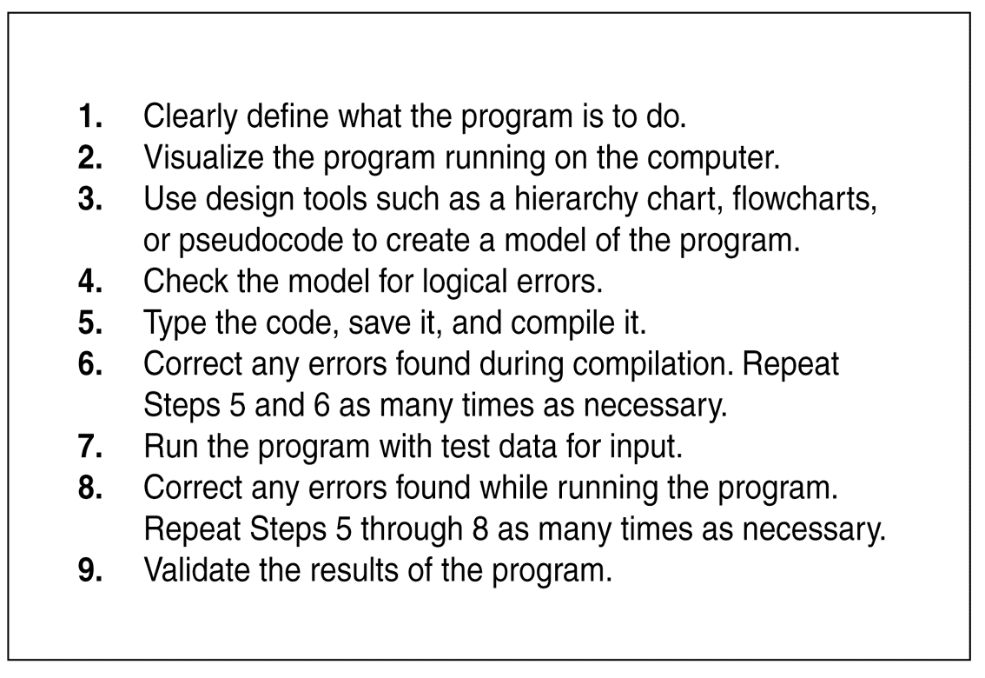
The Programming Process

Slide 37
Procedural and Object-Oriented Programming
Procedural programming: focus is on the process. Procedures/functions are written to process data.
Object-Oriented programming: focus is on objects, which contain data and the means to manipulate the data. Messages sent to objects to perform operations.

Slide 38
Parts of a C++ Program
comment
// sample C++ program
#include <iostream>
using namespace std;
int main()
{
cout << "Hello, there!";
return 0;
}
preprocessor
directive
which namespace
to use
beginning of
function named main
beginning of
block for main
output
statement
string
literal
end of block
for main
send 0 to
operating system

Slide 39
Special Characters
Character | Name | Meaning
// | Double slash | Beginning of a comment
# | Pound sign | Beginning of preprocessor directive
< > | Open/close brackets | Enclose filename in #include
( ) | Open/close parentheses | Used when naming a function
{ } | Open/close brace | Encloses a group of statements
" " | Open/close quotation marks | Encloses string of characters
; | Semicolon | End of a programming statement

Slide 40
The cout Object
Displays output on the computer screen
You use the stream insertion operator << to send output to cout:
cout << "Programming is fun!";

Slide 41
The cout Object
Can be used to send more than one item to cout:
cout << "Hello " << "there!";
Or:
cout << "Hello ";
cout << "there!";

Slide 42
The cout Object
This produces one line of output: cout << "Programming is "; cout << "fun!";

Slide 43
The endl Manipulator
You can use the endl manipulator to start a new line of output. This will produce two lines of output: cout << "Programming is" << endl; cout << "fun!";

Slide 44
The endl Manipulator
cout << "Programming is" << endl; cout << "fun!";
Programming is
fun!

Slide 45
The endl Manipulator
You do NOT put quotation marks around endl
The last character in endl is a lowercase L, not the number 1.
endl
This is a lowercase L

Slide 46
The \n Escape Sequence
You can also use the \n escape sequence to start a new line of output. This will produce two lines of output: cout << "Programming is\n"; cout << "fun!";
Notice that the \n is INSIDE the string.

Slide 47
The \n Escape Sequence
cout << "Programming is\n"; cout << "fun!";
Programming is
fun!

Slide 48
The #include Directive
Inserts the contents of another file into the program
This is a preprocessor directive, not part of C++ language
#include lines not seen by compiler
Do not place a semicolon at end of #include line

Slide 49
Variables and Literals
Variable: a storage location in memory
Has a name and a type of data it can hold
Must be defined before it can be used:
int item;

Slide 50
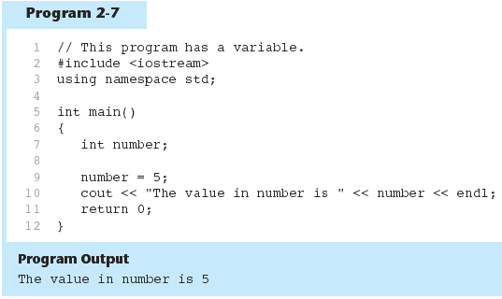
Variable Definition

Slide 51
Literals
Literal: a value that is written into a program’s code.
"hello, there" (string literal)
12 (integer literal)

Slide 52
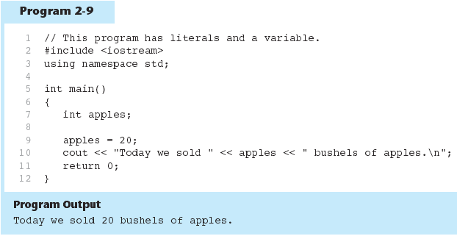
20 is an integer literal

Slide 53
This is a string literal

Slide 54
This is also a string literal

Slide 55
Identifiers
An identifier is a programmer-defined name for some part of a program: variables, functions, etc.

Slide 56
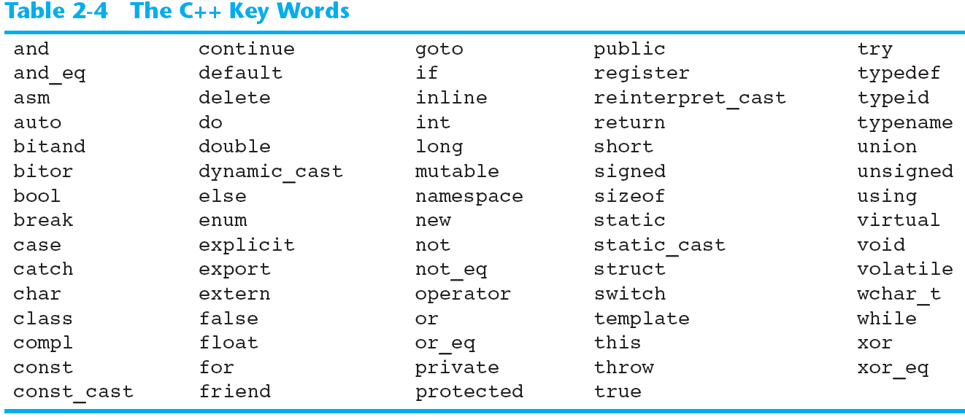
C++ Key Words
You cannot use any of the C++ key words as an identifier. These words have reserved meaning.

Slide 57
Variable Names
A variable name should represent the purpose of the variable. For example: itemsOrdered The purpose of this variable is to hold the number of items ordered.

Slide 58
Identifier Rules
The first character of an identifier must be an alphabetic character or and underscore ( _ ),
After the first character you may use alphabetic characters, numbers, or underscore characters.
Upper- and lowercase characters are distinct

Slide 59
Valid and Invalid Identifiers
IDENTIFIER | VALID? | REASON IF INVALID
totalSales | Yes
total_Sales | Yes
total.Sales | No | Cannot contain .
4thQtrSales | No | Cannot begin with digit
totalSale$ | No | Cannot contain $

Slide 60
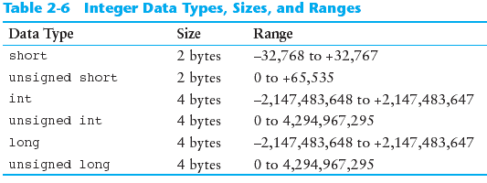
Integer Data Types
Integer variables can hold whole numbers such as 12, 7, and -99.

Slide 61
Defining Variables
Variables of the same type can be defined
- On separate lines:
int length;
int width;
unsigned int area;
- On the same line:
int length, width;
unsigned int area;
Variables of different types must be in different definitions

Slide 62
Integer Literals
An integer literal is an integer value that is typed into a program’s code. For example: itemsOrdered = 15; In this code, 15 is an integer literal.

Slide 63
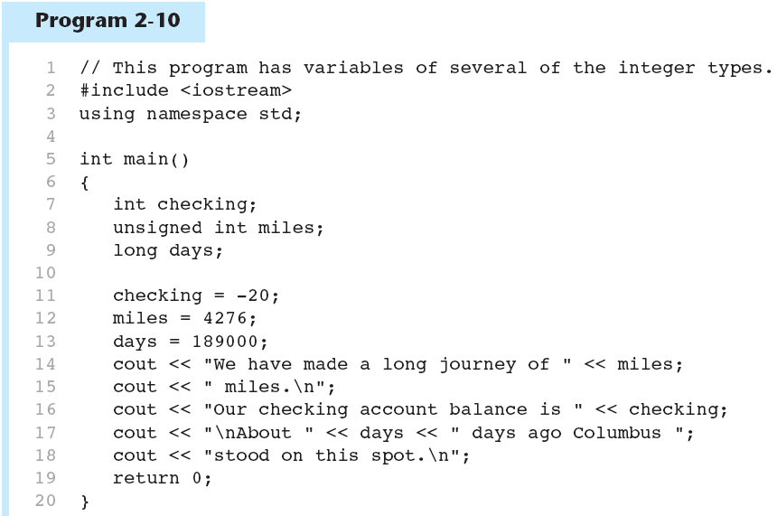
Integer Literals

Slide 64
Integer Literals
Integer literals are stored in memory as ints by default
To store an integer constant in a long memory location, put ‘L’ at the end of the number: 1234L
Constants that begin with ‘0’ (zero) are base 8: 075
Constants that begin with ‘0x’ are base 16: 0x75A

Slide 65
The char Data Type
Used to hold characters or very small integer values
Usually 1 byte of memory
Numeric value of character from the character set is stored in memory:
CODE:
char letter;
letter = 'C';
MEMORY:
letter
67

Slide 66
Character Literals
Character literals must be enclosed in single quote marks. Example: 'A'

Slide 67
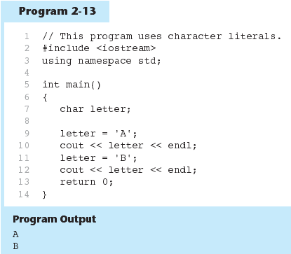

Slide 68
Character Strings
A series of characters in consecutive memory locations:
"Hello"
Stored with the null terminator, \0, at the end:
Comprised of the characters between the " "
H | e | l | l | o | \0

Slide 69
Floating-Point Data Types
The floating-point data types are: float double long double
They can hold real numbers such as:
12.45 -3.8
Stored in a form similar to scientific notation
All floating-point numbers are signed

Slide 70
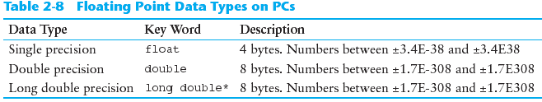
Floating-Point Data Types

Slide 71
Floating-point Literals
Can be represented in
Fixed point (decimal) notation:
31.4159 0.0000625
E notation:
3.14159E1 6.25e-5
Are double by default
Can be forced to be float (3.14159f) or long double (0.0000625L)

Slide 72
The bool Data Type
Represents values that are true or false
bool variables are stored as small integers
false is represented by 0, true by 1:
bool allDone = true;
bool finished = false;
allDone
finished
1
0

Slide 73
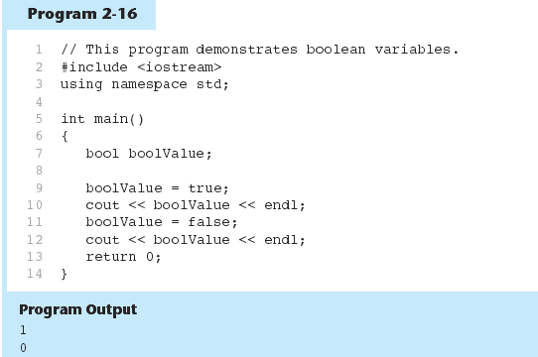

Slide 74
Determining the Size of a Data Type
The sizeof operator gives the size of any data type or variable:
double amount;
cout << "A double is stored in "
<< sizeof(double) << "bytes\n";
cout << "Variable amount is stored in "
<< sizeof(amount)
<< "bytes\n";

Slide 75
Variable Assignments and Initialization
An assignment statement uses the = operator to store a value in a variable. item = 12;
This statement assigns the value 12 to the item variable.

Slide 76
Assignment
The variable receiving the value must appear on the left side of the = operator.
This will NOT work: // ERROR! 12 = item;

Slide 77
Variable Initialization
To initialize a variable means to assign it a value when it is defined:
int length = 12;
Can initialize some or all variables:
int length = 12, width = 5, area;

Slide 78
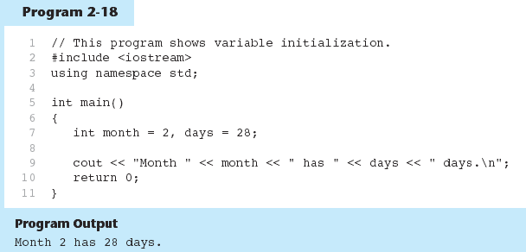

Slide 79
Scope
The scope of a variable: the part of the program in which the variable can be accessed
A variable cannot be used before it is defined

Slide 80
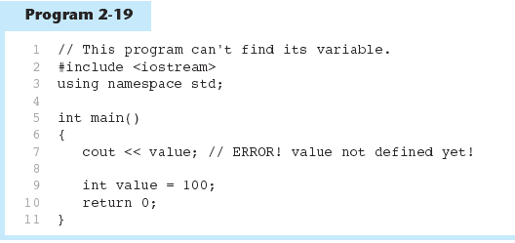

Slide 81
Arithmetic Operators
Used for performing numeric calculations
C++ has unary, binary, and ternary operators:
unary (1 operand) -5
binary (2 operands) 13 - 7
ternary (3 operands) exp1 ? exp2 : exp3

Slide 82
Binary Arithmetic Operators
SYMBOL | OPERATION | EXAMPLE | VALUE OF ans
+ | addition | ans = 7 + 3; | 10
- | subtraction | ans = 7 - 3; | 4
* | multiplication | ans = 7 * 3; | 21
/ | division | ans = 7 / 3; | 2
% | modulus | ans = 7 % 3; | 1

Slide 83
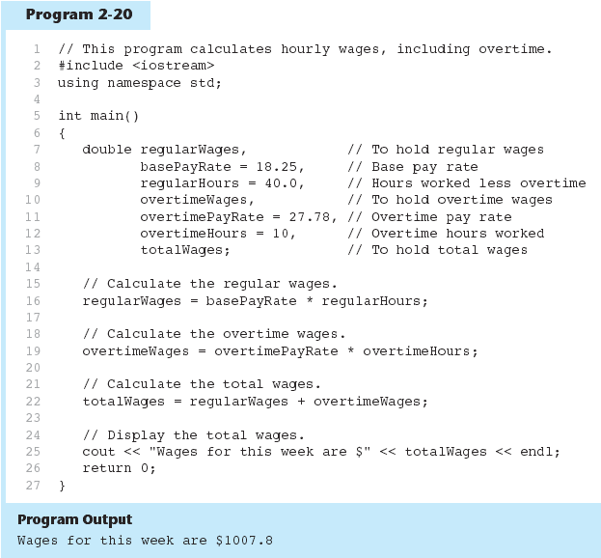

Slide 84
A Closer Look at the / Operator
/ (division) operator performs integer division if both operands are integers
cout << 13 / 5; // displays 2
cout << 91 / 7; // displays 13
If either operand is floating point, the result is floating point
cout << 13 / 5.0; // displays 2.6
cout << 91.0 / 7; // displays 13.0

Slide 85
A Closer Look at the % Operator
% (modulus) operator computes the remainder resulting from integer division
cout << 13 % 5; // displays 3
% requires integers for both operands
cout << 13 % 5.0; // error

Slide 86
Comments
Used to document parts of the program
Intended for persons reading the source code of the program:
Indicate the purpose of the program
Describe the use of variables
Explain complex sections of code
Are ignored by the compiler

Slide 87
Single-Line Comments
Begin with // through to the end of line:
int length = 12; // length in inches
int width = 15; // width in inches
int area; // calculated area
// calculate rectangle area
area = length * width;

Slide 88
Multi-Line Comments
Begin with /*, end with */
Can span multiple lines:
/* this is a multi-line
comment
*/
Can begin and end on the same line:
int area; /* calculated area */

Slide 89
Programming Style
The visual organization of the source code
Includes the use of spaces, tabs, and blank lines
Does not affect the syntax of the program
Affects the readability of the source code

Slide 90
Programming Style
Common elements to improve readability:
Braces { } aligned vertically
Indentation of statements within a set of braces
Blank lines between declaration and other statements
Long statements wrapped over multiple lines with aligned operators

Slide 91
Standard and Prestandard C++
Older-style C++ programs:
Use .h at end of header files:
#include <iostream.h>
Do not use using namespace convention
May not compile with a standard C++ compiler

Slide 92
The cin Object
Standard input object
Like cout, requires iostream file
Used to read input from keyboard
Information retrieved from cin with >>
Input is stored in one or more variables

Slide 93
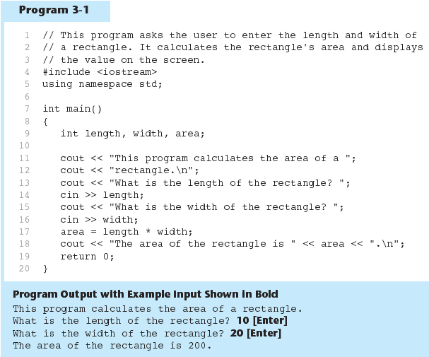

Slide 94
The cin Object
cin converts data to the type that matches the variable:
int height;
cout << "How tall is the room? ";
cin >> height;

Slide 95
Displaying a Prompt
A prompt is a message that instructs the user to enter data.
You should always use cout to display a prompt before each cin statement. cout << "How tall is the room? "; cin >> height;

Slide 96
The cin Object
Can be used to input more than one value:
cin >> height >> width;
Multiple values from keyboard must be separated by spaces
Order is important: first value entered goes to first variable, etc.

Slide 97
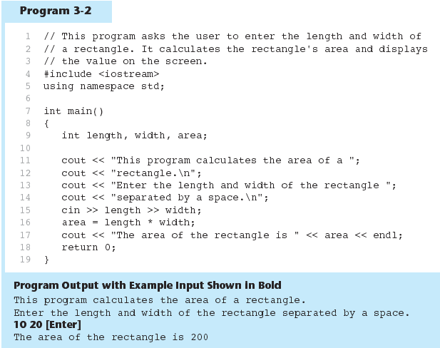

Slide 98
Reading Strings with cin
Can be used to read in a string
Must first declare an array to hold characters in string:
char myName[21];
nyName is name of array, 21 is the number of characters that can be stored (the size of the array), including the NULL character at the end
Can be used with cin to assign a value:
cin >> myName;

Slide 99
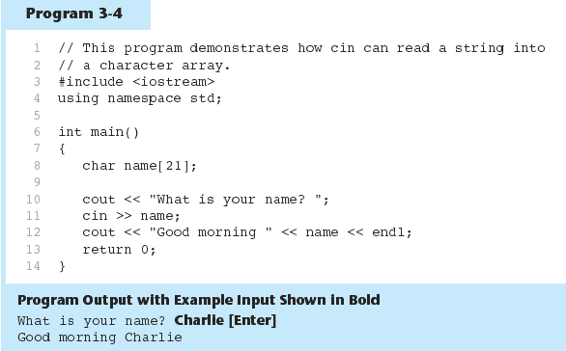

Slide 100
Mathematical Expressions
Can create complex expressions using multiple mathematical operators
An expression can be a literal, a variable, or a mathematical combination of constants and variables
Can be used in assignment, cout, other statements:
area = 2 * PI * radius;
cout << "border is: " << 2*(l+w);

Slide 101
Order of Operations
In an expression with more than one operator, evaluate in this order:
- (unary negation), in order, left to right
* / %, in order, left to right
+ -, in order, left to right
In the expression 2 + 2 * 2 – 2
evaluate
first
evaluate
third
evaluate
second

Slide 102
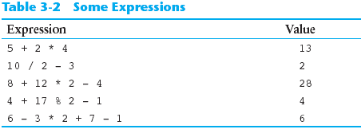
Order of Operations

Slide 103
Associativity of Operators
- (unary negation) associates right to left
*, /, %, +, - associate right to left
parentheses ( ) can be used to override the order of operations:
2 + 2 * 2 – 2 = 4
(2 + 2) * 2 – 2 = 6
2 + 2 * (2 – 2) = 2
(2 + 2) * (2 – 2) = 0

Slide 104
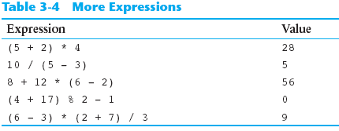
Grouping with Parentheses

Slide 105
Algebraic Expressions
Multiplication requires an operator:
Area=lw is written as Area = l * w;
There is no exponentiation operator:
Area=s² is written as Area = pow(s, 2);
Parentheses may be needed to maintain order of operations:
is written as
m = (y2-y1) /(x2-x1);

Slide 106
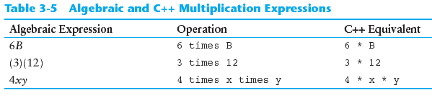
Algebraic Expressions

Slide 107
When You Mix Apples and Oranges: Type Conversion
Operations are performed between operands of the same type.
If not of the same type, C++ will convert one to be the type of the other
This can impact the results of calculations.

Slide 108
Hierarchy of Types
long double
double
float
unsigned long
long
unsigned int
int
Highest:
Lowest:
Ranked by largest number they can hold

Slide 109
C-Style and Prestandard Type Cast Expressions
C-Style cast: data type name in ()
cout << ch << " is " << (int)ch;
Prestandard C++ cast: value in ()
cout << ch << " is " << int(ch);
Both are still supported in C++, although static_cast is preferred

Slide 110
Named Constants
Named constant (constant variable): variable whose content cannot be changed during program execution
Used for representing constant values with descriptive names:
const double TAX_RATE = 0.0675;
const int NUM_STATES = 50;
Often named in uppercase letters

Slide 111
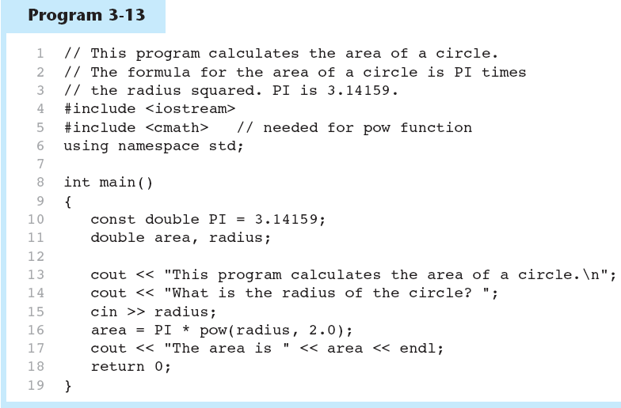

Slide 112
Constants and Array Sizes
It is a common practice to use a named constant to indicate the size of an array: const int SIZE = 21; char name[SIZE];

Slide 113
const vs. #define
#define – C-style of naming constants:
#define NUM_STATES 50
Note no semicolon at end
Interpreted by pre-processor rather than compiler
Does not occupy memory location like const

Slide 114
Multiple Assignment and Combined Assignment
The = can be used to assign a value to multiple variables:
x = y = z = 5;
Value of = is the value that is assigned
Associates right to left:
x = (y = (z = 5));
value
is 5
value
is 5
value
is 5

Slide 115
Combined Assignment
Look at the following statement:
sum = sum + 1;
This adds 1 to the variable sum.

Slide 116
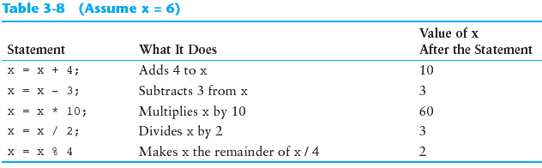
Other Similar Statements

Slide 117
Combined Assignment
The combined assignment operators provide a shorthand for these types of statements.
The statement
sum = sum + 1;
is equivalent to
sum += 1;

Slide 118
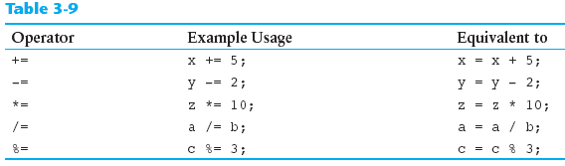
Combined Assignment Operators

Slide 119
Formatting Output
Can control how output displays for numeric, string data:
size
position
number of digits
Requires iomanip header file

Slide 120
Stream Manipulators
Used to control how an output field is displayed
Some affect just the next value displayed:
setw(x): print in a field at least x spaces wide. Use more spaces if field is not wide enough

Slide 121
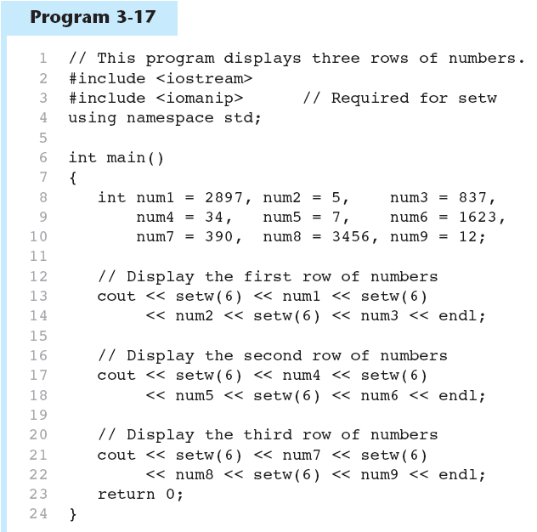
Continued…

Slide 122
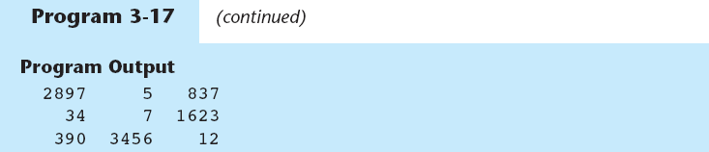

Slide 123
Stream Manipulators
Some affect values until changed again:
fixed: use decimal notation for floating-point values
setprecision(x): when used with fixed, print floating-point value using x digits after the decimal. Without fixed, print floating-point value using x significant digits
showpoint: always print decimal for floating-point values

Slide 124
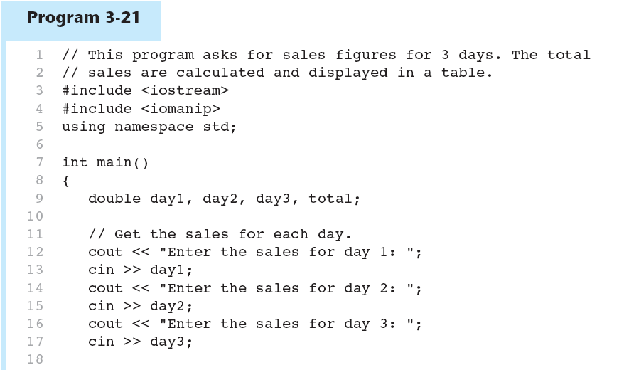
Continued…

Slide 125
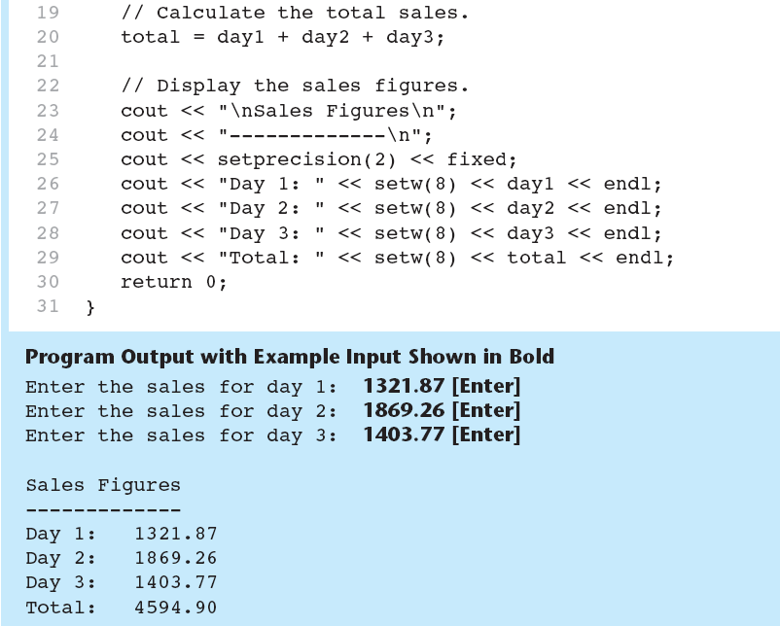

Slide 126
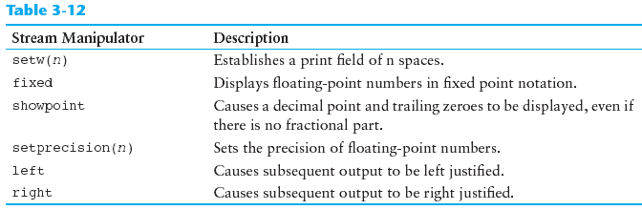
Stream Manipulators

Slide 127
Formatted Input
Can format field width for use with cin
Useful when reading string data to be stored in a character array: const int SIZE = 10;
char firstName[SIZE];
cout << "Enter your name: ";
cin >> setw(SIZE) >> firstName;
cin reads one less character than specified with the setw() manipulator

Slide 128
Formatted Input
To read an entire line of input, use cin.getline():
const int SIZE = 81; char address[SIZE];
cout << "Enter your address: ";
cin.getline(address, SIZE);
cin.getline takes two arguments:
Name of array to store string
Size of the array

Slide 129
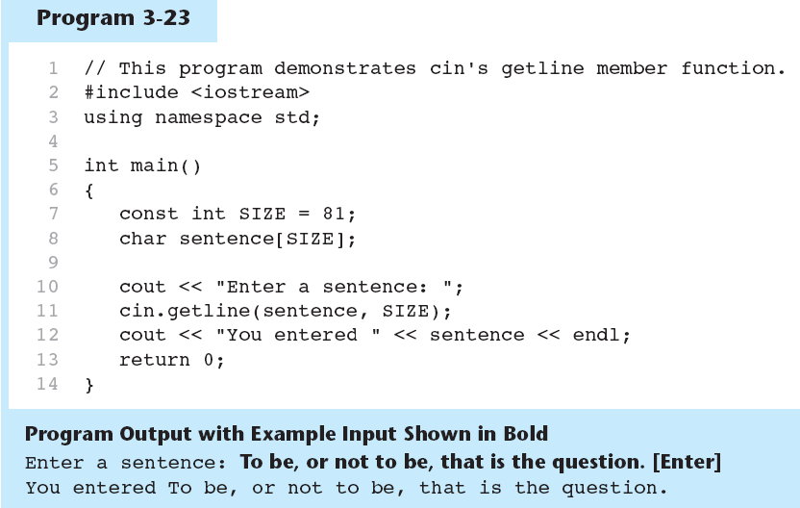

Slide 130
Formatted Input
To read a single character:
Use cin:
char ch;
cout << "Strike any key to continue";
cin >> ch;
Problem: will skip over blanks, tabs, <CR>
Use cin.get():
cin.get(ch);
Will read the next character entered, even whitespace

Slide 131
Formatted Input
Mixing cin >> and cin.get() in the same program can cause input errors that are hard to detect
To skip over unneeded characters that are still in the keyboard buffer, use cin.ignore():
cin.ignore(); // skip next char
cin.ignore(10, '\n'); // skip the next
// 10 char. or until a '\n'

Slide 132
More About Member Functions
Member Function: procedure that is part of an object
cout, cin are objects
Some member functions of the cin object:
getline
get
ignore

Slide 133
More Mathematical Library Functions
Require cmath header file
Take double as input, return a double
Commonly used functions:
sin | Sine
cos | Cosine
tan | Tangent
sqrt | Square root
log | Natural (e) log
abs | Absolute value (takes and returns an int)

Slide 134
More Mathematical Library Functions
These require cstdlib header file
rand(): returns a random number (int) between 0 and the largest int the compute holds. Yields same sequence of numbers each time program is run.
srand(x): initializes random number generator with unsigned int x

Slide 135
Hand Tracing a Program
Hand trace a program: act as if you are the computer, executing a program:
step through and ‘execute’ each statement, one-by-one
record the contents of variables after statement execution, using a hand trace chart (table)
Useful to locate logic or mathematical errors

Slide 136
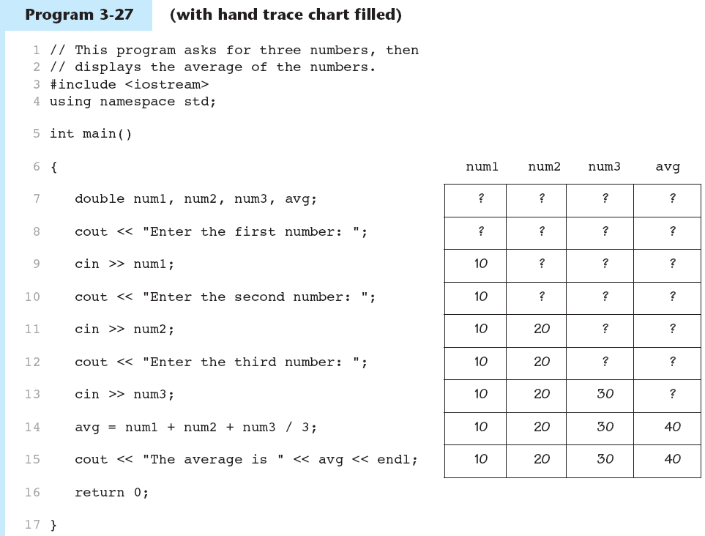

Slide 137
Introduction to File Input and Output
Can use files instead of keyboard, monitor screen for program input, output
Allows data to be retained between program runs
Steps:
Open the file
Use the file (read from, write to, or both)
Close the file

Slide 138
Files: What is Needed
Use fstream header file for file access
File stream types:
ifstream for input from a file
ofstream for output to a file
fstream for input from or output to a file
Define file stream objects:
ifstream infile;
ofstream outfile;

Slide 139
Opening Files
Create a link between file name (outside the program) and file stream object (inside the program)
Use the open member function:
infile.open("inventory.dat");
outfile.open("report.txt");
Filename may include drive, path info.
Output file will be created if necessary; existing file will be erased first
Input file must exist for open to work

Slide 140
Using Files
Can use output file object and << to send data to a file:
outfile << "Inventory report";
Can use input file object and >> to copy data from file to variables:
infile >> partNum;
infile >> qtyInStock >> qtyOnOrder;

Slide 141
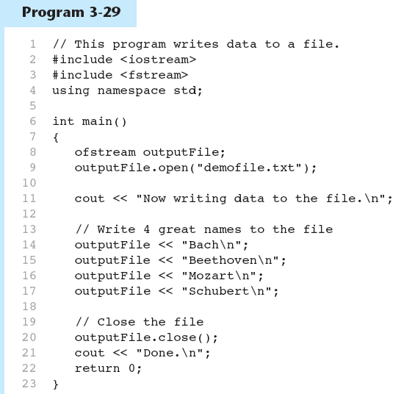
Continued…

Slide 142
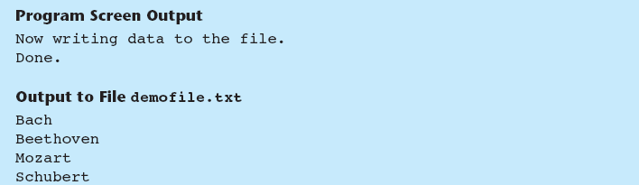

Slide 143
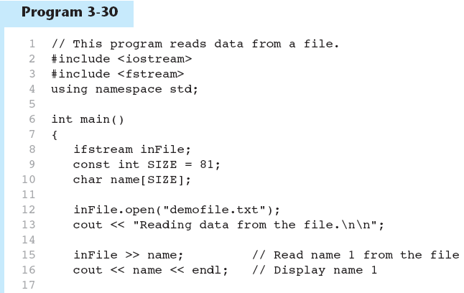
Continued…

Slide 144
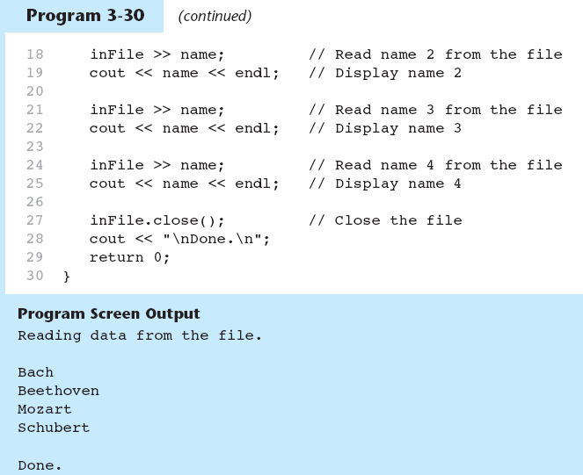

Slide 145
Relational Expressions
Boolean expressions – true or false
Examples:
12 > 5 is true
7 <= 5 is false
if x is 10, then
x == 10 is true,
x != 8 is true, and
x == 8 is false

Slide 146
Relational Expressions
Can be assigned to a variable:
result = x <= y;
Assigns 0 for false, 1 for true
Do not confuse = and ==

Slide 147
The if Statement
Allows statements to be conditionally executed or skipped over
Models the way we mentally evaluate situations:
"If it is raining, take an umbrella."
"If it is cold outside, wear a coat."

Slide 148
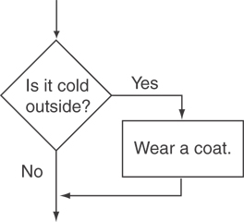
Flowchart for Evaluating a Decision

Slide 149
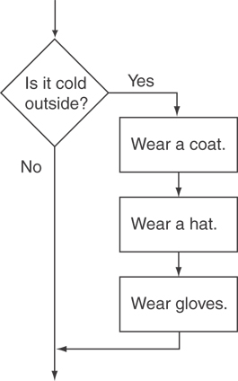
Flowchart for Evaluating a Decision

Slide 150
The if Statement
General Format:
if (expression)
statement;

Slide 151
if statement – what happens
To evaluate:
if (expression)
statement;
If the expression is true, then statement is executed.
If the expression is false, then statement is skipped.

Slide 152
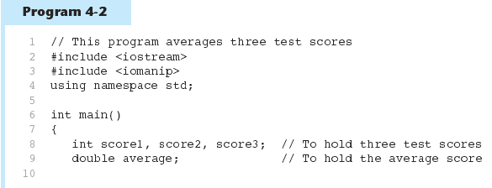
(Program Continues)

Slide 153
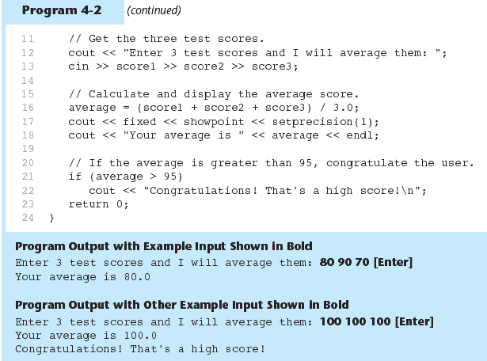

Slide 154
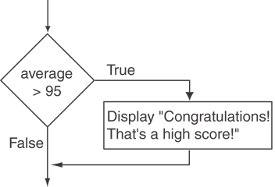
Flowchart for Lines 21 and 22

Slide 155
if statement notes
Do not place ; after (expression)
Place statement; on a separate line after (expression), indented:
if (score > 90)
grade = 'A';
Be careful testing floats and doubles for equality
0 is false; any other value is true

Slide 156
Flags
Variable that signals a condition
Usually implemented as a bool variable
As with other variables in functions, must be assigned an initial value before it is used

Slide 157
Expanding the if Statement
To execute more than one statement as part of an if statement, enclose them in { }:
if (score > 90)
{
grade = 'A';
cout << "Good Job!\n";
}
{ } creates a block of code

Slide 158
The if/else Statement
Provides two possible paths of execution
Performs one statement or block if the expression is true, otherwise performs another statement or block.

Slide 159
The if/else Statement
General Format:
if (expression)
statement1; // or block
else
statement2; // or block

Slide 160
if/else – what happens
To evaluate:
if (expression)
statement1;
else
statement2;
If the expression is true, then statement1 is executed and statement2 is skipped.
If the expression is false, then statement1 is skipped and statement2 is executed.

Slide 161
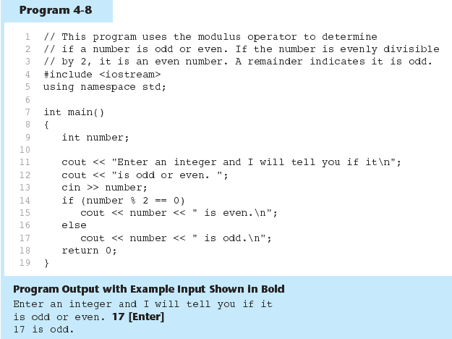

Slide 162
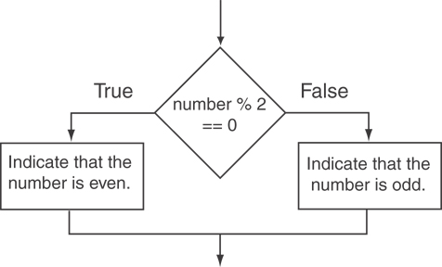
Flowchart for Lines 14 through 18

Slide 163
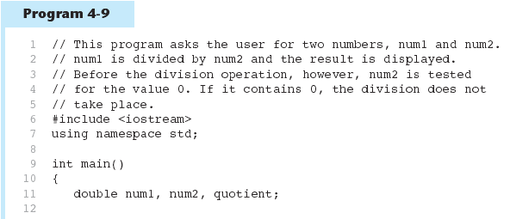
(Program Continues)

Slide 164
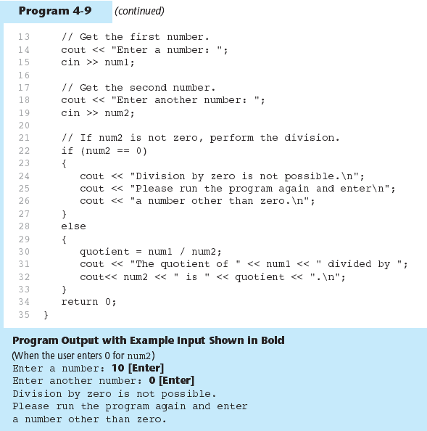

Slide 165
Nested if Statements
An if statement that is nested inside another if statement
Nested if statements can be used to test more than one condition

Slide 166
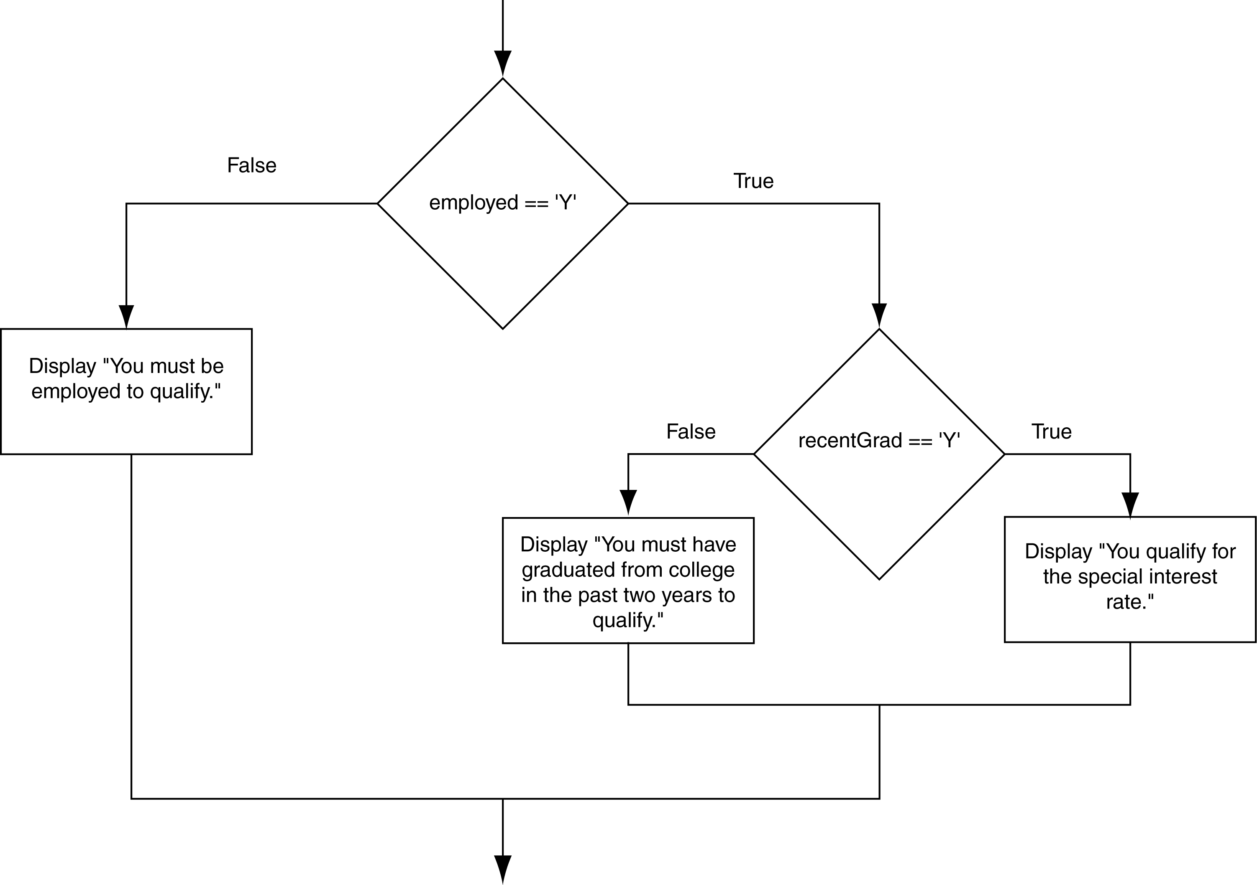
Flowchart for a Nested if Statement

Slide 167
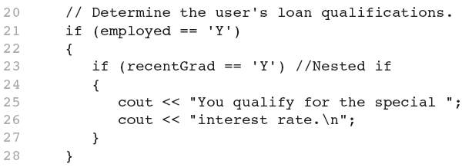
Nested if Statements
From Program 4-10

Slide 168
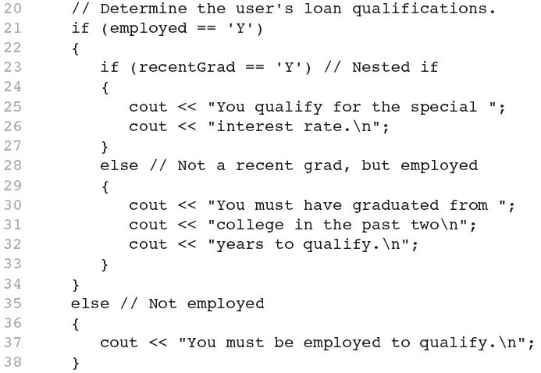
Nested if Statements
Another example, from Program 4-11

Slide 169

Use Proper Indentation!

Slide 170
The if/else if Statement
Tests a series of conditions until one is found to be true
Often simpler than using nested if/else statements
Can be used to model thought processes such as: "If it is raining, take an umbrella, else, if it is windy, take a hat, else, take sunglasses”

Slide 171
if/else if format
if (expression)
statement1; // or block
else if (expression)
statement2; // or block
.
. // other else ifs .
else if (expression)
statementn; // or block

Slide 172

From Program 4-13

Slide 173
Using a Trailing else to Catch Errors
The trailing else clause is optional, but is best used to catch errors
From Program 4-14:
This trailing else catches invalid test scores
15 // Determine the letter grade. 16 if (testScore < 60) 17 cout << "Your grade is F.\n"; 18 else if (testScore < 70) 19 cout << "Your grade is D.\n"; 20 else if (testScore < 80) 21 cout << "Your grade is C.\n"; 22 else if (testScore < 90) 23 cout << "Your grade is B.\n"; 24 else if (testScore <= 100) 25 cout << "Your grade is A.\n"; 26 else 27 cout << "We do not give scores higher than 100.\n";

Slide 174
Menus
Menu-driven program: program execution controlled by user selecting from a list of actions
Menu: list of choices on the screen
Menus can be implemented using if/else if statements

Slide 175
Menu-driven program organization
Display list of numbered or lettered choices for actions
Prompt user to make selection
Test user selection in expression
if a match, then execute code for action
if not, then go on to next expression

Slide 176
Logical Operators
Used to create relational expressions from other relational expressions
Operators, meaning, and explanation:
&& | AND | New relational expression is true if both expressions are true
|| | OR | New relational expression is true if either expression is true
! | NOT | Reverses the value of an expression – true expression becomes false, and false becomes true

Slide 177
Logical Operators - examples
int x = 12, y = 5, z = -4;
(x > y) && (y > z) | true
(x > y) && (z > y) | false
(x <= z) || (y == z) | false
(x <= z) || (y != z) | true
!(x >= z) | false

Slide 178

The && Operator in Program 4-16

Slide 179

The || Operator in Program 4-17

Slide 180

The ! Operator in Program 4-18

Slide 181
Logical Operators - notes
! has highest precedence, followed by &&, then ||
If the value of an expression can be determined by evaluating just the sub-expression on left side of a logical operator, then the sub-expression on the right side will not be evaluated (short circuit evaluation)

Slide 182
Checking Numeric Ranges with Logical Operators
Used to test to see if a value falls inside a range:
if (grade >= 0 && grade <= 100)
cout << "Valid grade";
Can also test to see if value falls outside of range:
if (grade <= 0 || grade >= 100)
cout << "Invalid grade";
Cannot use mathematical notation:
if (0 <= grade <= 100) //doesn’t work!

Slide 183
Validating User Input
Input validation: inspecting input data to determine whether it is acceptable
Bad output will be produced from bad input
Can perform various tests:
Range
Reasonableness
Valid menu choice
Divide by zero

Slide 184

From Program 4-19

Slide 185
More About Variable Definitions and Scope
Scope of a variable is the block in which it is defined, from the point of definition to the end of the block
Usually defined at beginning of function
May be defined close to first use

Slide 186

From Program 4-21

Slide 187
Still More About Variable Definitions and Scope
Variables defined inside { } have local or block scope
When inside a block within another block, can define variables with the same name as in the outer block.
When in inner block, outer definition is not available
Not a good idea

Slide 188
Comparing Strings
You cannot use relational operators with C-strings
Must use the strcmp function to compare C-strings
strcmp compares the ASCII codes of the characters in the C-strings. Comparison is character-by-character

Slide 189
Comparing Strings
The expression strcmp(str1, str2) compares the strings str1 and str2
It returns 0 if the strings are the same
It returns a negative number if str1 < str2
It returns a positive number if str1 > str2

Slide 190


Slide 191


Slide 192
The Conditional Operator
Can use to create short if/else statements
Format: expr ? expr : expr;
x<0 ? y=10 : z=20;
First Expression:
Expression to be
tested
2nd Expression:
Executes if first
expression is true
3rd Expression:
Executes if the first
expression is false

Slide 193
The Conditional Operator
The value of a conditional expression is
The value of the second expression if the first expression is true
The value of the third expression if the first expression is false
Parentheses () may be needed in an expression due to precedence of conditional operator

Slide 194


Slide 195
4.15
The switch Statement

Slide 196
The switch Statement
Used to select among statements from several alternatives
In some cases, can be used instead of if/else if statements

Slide 197
switch statement format
switch (expression) //integer
{
case exp1: statement1;
case exp2: statement2;
...
case expn: statementn;
default: statementn+1;
}

Slide 198


Slide 199
switch statement requirements
1) expression must be an integer variable or an expression that evaluates to an integer value
exp1 through expn must be constant integer expressions or literals, and must be unique in the switch statement
default is optional but recommended

Slide 200
switch statement – how it works
1) expression is evaluated
The value of expression is compared against exp1 through expn.
If expression matches value expi, the program branches to the statement following expi and continues to the end of the switch
If no matching value is found, the program branches to the statement after default:

Slide 201
break statement
Used to exit a switch statement
If it is left out, the program "falls through" the remaining statements in the switch statement

Slide 202


Slide 203



Slide 204
Using switch with a menu
switch statement is a natural choice for menu-driven program:
display the menu
then, get the user's menu selection
use user input as expression in switch statement
use menu choices as expr in case statements

Slide 205
Testing for File Open Errors
Can test a file stream object to detect if an open operation failed:
infile.open("test.txt");
if (!infile)
{
cout << "File open failure!";
}
Can also use the fail member function

Slide 206
The Increment and Decrement Operators
++ is the increment operator. It adds one to a variable.
val++; is the same as val = val + 1;
++ can be used before (prefix) or after (postfix) a variable:
++val; val++;

Slide 207
The Increment and Decrement Operators
-- is the decrement operator. It subtracts one from a variable.
val--; is the same as val = val - 1;
-- can be also used before (prefix) or after (postfix) a variable:
--val; val--;

Slide 208

(Program Continues)

Slide 209


Slide 210
Prefix vs. Postfix
++ and -- operators can be used in complex statements and expressions
In prefix mode (++val, --val) the operator increments or decrements, then returns the value of the variable
In postfix mode (val++, val--) the operator returns the value of the variable, then increments or decrements

Slide 211
Prefix vs. Postfix - Examples
int num, val = 12;
cout << val++; // displays 12,
// val is now 13;
cout << ++val; // sets val to 14,
// then displays it
num = --val; // sets val to 13,
// stores 13 in num
num = val--; // stores 13 in num,
// sets val to 12

Slide 212
Notes on Increment, Decrement
Can be used in expressions:
result = num1++ + --num2;
Must be applied to something that has a location in memory. Cannot have:
result = (num1 + num2)++;
Can be used in relational expressions:
if (++num > limit)
pre- and post-operations will cause different comparisons

Slide 213
Introduction to Loops: The while Loop
Loop: a control structure that causes a statement or statements to repeat
General format of the while loop:
while (expression)
statement;
statement; can also be a block of statements enclosed in { }

Slide 214
while Loop – How It Works
while (expression)
statement;
expression is evaluated
if true, then statement is executed, and expression is evaluated again
if false, then the the loop is finished and program statements following statement execute

Slide 215

The Logic of a while Loop

Slide 216


Slide 217

How the Loop in Lines 9 through 13 Works

Slide 218

Flowchart of the Loop

Slide 219
while is a Pretest Loop
expression is evaluated before the loop executes. The following loop will never execute: int number = 6; while (number <= 5) { cout << "Hello\n"; number++; }

Slide 220
Watch Out for Infinite Loops
The loop must contain code to make expression become false
Otherwise, the loop will have no way of stopping
Such a loop is called an infinite loop, because it will repeat an infinite number of times

Slide 221
An Infinite Loop
int number = 1; while (number <= 5) { cout << "Hello\n"; }

Slide 222
Using the while Loop for Input Validation
Input validation is the process of inspecting data that is given to the program as input and determining whether it is valid.
The while loop can be used to create input routines that reject invalid data, and repeat until valid data is entered.

Slide 223
Using the while Loop for Input Validation
Here's the general approach, in pseudocode:
Read an item of input. While the input is invalid Display an error message. Read the input again. End While

Slide 224
Input Validation Example
cout << "Enter a number less than 10: ";
cin >> number;
while (number >= 10)
{
cout << "Invalid Entry!" << "Enter a number less than 10: ";
cin >> number;
}

Slide 225

Flowchart

Slide 226

Input Validation Example from Program 5-5

Slide 227
Counters
Counter: a variable that is incremented or decremented each time a loop repeats
Can be used to control execution of the loop (also known as the loop control variable)
Must be initialized before entering loop

Slide 228



Slide 229


Slide 230
The do-while Loop
do-while: a posttest loop – execute the loop, then test the expression
General Format:
do
statement; // or block in { }
while (expression);
Note that a semicolon is required after (expression)

Slide 231

The Logic of a do-while Loop

Slide 232
do-while Example
int x = 1; do { cout << x << endl; } while(x < 0);
Although the test expression is false, this loop will execute one time because do-while is a posttest loop.

Slide 233



Slide 234


Slide 235
do-while Loop Notes
Loop always executes at least once
Execution continues as long as expression is true, stops repetition when expression becomes false
Useful in menu-driven programs to bring user back to menu to make another choice (see Program 5-8 in the book)

Slide 236
The for Loop
Useful for counter-controlled loop
General Format:
for(initialization; test; update)
statement; // or block in { }
No semicolon after 3rd expression or after the )

Slide 237
for Loop - Mechanics
for(initialization; test; update)
statement; // or block in { }
Perform initialization
Evaluate test expression
If true, execute statement
If false, terminate loop execution
Execute update, then re-evaluate test expression

Slide 238
for Loop - Example
int count;
for (count = 1; count <= 5; count++)
cout << "Hello" << endl;

Slide 239

A Closer Look at the Previous Example

Slide 240

Flowchart for the Previous Example

Slide 241


Slide 242


Slide 243

A Closer Look at Lines 13 through 14 in Program 5-9

Slide 244

Flowchart for Lines 13 through 14 in Program 5-9

Slide 245
When to Use the for Loop
In any situation that clearly requires
an initialization
a false condition to stop the loop
an update to occur at the end of each iteration

Slide 246
The for Loop is a Pretest Loop
The for loop tests its test expression before each iteration, so it is a pretest loop.
The following loop will never iterate: for (count = 11; count <= 10; count++) cout << "Hello" << endl;

Slide 247
for Loop - Modifications
You can have multiple statements in the initialization expression. Separate the statements with a comma: int x, y; for (x=1, y=1; x <= 5; x++) { cout << x << " plus " << y << " equals " << (x+y) << endl; }
Initialization Expression

Slide 248
for Loop - Modifications
You can also have multiple statements in the test expression. Separate the statements with a comma: int x, y; for (x=1, y=1; x <= 5; x++, y++) { cout << x << " plus " << y << " equals " << (x+y) << endl; }
Test Expression

Slide 249
for Loop - Modifications
You can omit the initialization expression if it has already been done:
int sum = 0, num = 1;
for (; num <= 10; num++)
sum += num;

Slide 250
for Loop - Modifications
You can declare variables in the initialization expression:
int sum = 0;
for (int num = 0; num <= 10; num++)
sum += num;
The scope of the variable num is the for loop.

Slide 251
Keeping a Running Total
running total: accumulated sum of numbers from each repetition of loop
accumulator: variable that holds running total
int sum=0, num=1; // sum is the
while (num <= 10) // accumulator
{ sum += num;
num++;
}
cout << "Sum of numbers 1 – 10 is"
<< sum << endl;

Slide 252


(Program Continues)

Slide 253



Slide 254
Sentinels
sentinel: value in a list of values that indicates end of data
Special value that cannot be confused with a valid value, e.g., -999 for a test score
Used to terminate input when user may not know how many values will be entered

Slide 255

(Program Continues)

Slide 256


Slide 257
Using a Loop to Read Data from a File
The stream extraction operator >> returns true when a value was successfully read, false otherwise
Can be tested in a while loop to continue execution as long as values are read from the file:
while (inputFile >> number) ...

Slide 258


Slide 259
Deciding Which Loop to Use
while: pretest loop; loop body may not be executed at all
do-while: posttest loop; loop body will always be executed at least once
for: pretest loop with initialization and update expression; useful with counters, or if precise number of repetitions is needed

Slide 260
Nested Loops
A nested loop is a loop inside the body of another loop
Inner (inside), outer (outside) loops:
for (row=1; row<=3; row++) //outer
for (col=1; col<=3; col++)//inner
cout << row * col << endl;

Slide 261

Lines from Program 5-16

Slide 262
Nested Loops - Notes
Inner loop goes through all repetitions for each repetition of outer loop
Inner loop repetitions complete sooner than outer loop
Total number of repetitions for inner loop is product of number of repetitions of the two loops.

Slide 263
Breaking Out of a Loop
Can use break to terminate execution of a loop
Use sparingly if at all – makes code harder to understand and debug
When used in an inner loop, terminates that loop only and goes back to outer loop

Slide 264
The continue Statement
Can use continue to go to end of loop and prepare for next repetition
while, do-while loops: go to test, repeat loop if test passes
for loop: perform update step, then test, then repeat loop if test passes
Use sparingly – like break, can make program logic hard to follow

